Slide 1

Welcome
Friendly app for Tailors by T.Durga Kumari

Slide 2
Background : Women are more interested in stitched dress to readymade dress. Stitched dresses gives more comfort and gives the flexibility to design as per individuals style. Observations : 1. Ladies doesn’t want to wait long time at the tailors shop. 2. Missing dress measurement details due to missing page in the book or book lost or writing wiped out. 3. Maintaining records of regular customers. 4. Retrieve measurement details from the old records. Solution : This app automates the work of Tailors and helps women in saving time while giving their cloths for stitching. Using this app…. 1. Tailor can enter all required details needed for stitching (like he notes in his book). PS: For now this app is abstract so only basic details are added just to portrait. 2. Tailor can get snap of the material and upload it with the measurement details. No need of cutting piece of the material and pinning it to the paper. 3. SMS option will be provided where details of the stitch with delivery date will be sent to the given customer contact number. So that, next time when women want to stitch material she has a copy of measurement info. PS: Yet to be developed 4. Display all stitch list option can be provided where tailor can search for the stitch information based on Customer Name and Date. PD: Yet to be developed. 5. Currently internal memory is used in this app for demo purpose. Later we can change this to external SD card memory as needed.
AppName : Tailors Desk Caption : Friendly app for Tailors

Slide 3
Functionalities covered in this App: 1) User can upload the image or change the uploaded image . 2) No Mandatory fields. 3) Allows only numeric values for phone number and numeric decimals for length and shoulder fields 4) Dropdown option for stitch style. 5) Save: is to save entered information to internal memory. 6) Display: is to show the saved information. 7) Clear: is to reset the fields to default values. 8) Popup confirmation message after successful save. 9) Date picker for selecting date of stitch. 10) Dress Delivery date. 11) Scroll bar. 12) 2 activities. 1) Create/upload stitching related details by Tailor. 2) To display saved information. PS: more input fields and collapse options need to be added. Application Configurations: 1) Developed on intelliJ 14. 2) Java 7 Compiler 3) Android 4.2.2 4) Galaxy Nexus API 17 Emulator

Slide 4
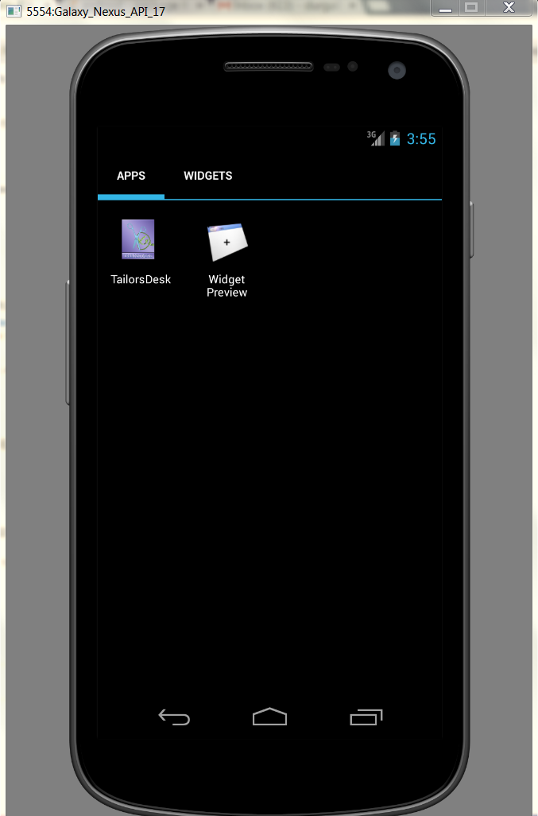

ICON

Slide 5
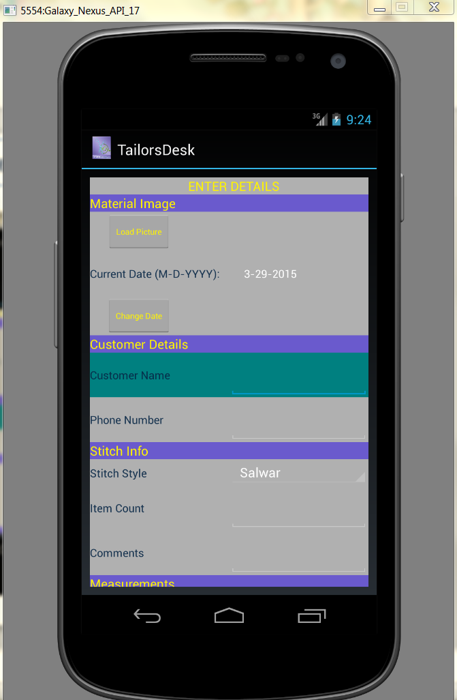
Home Page

Slide 6
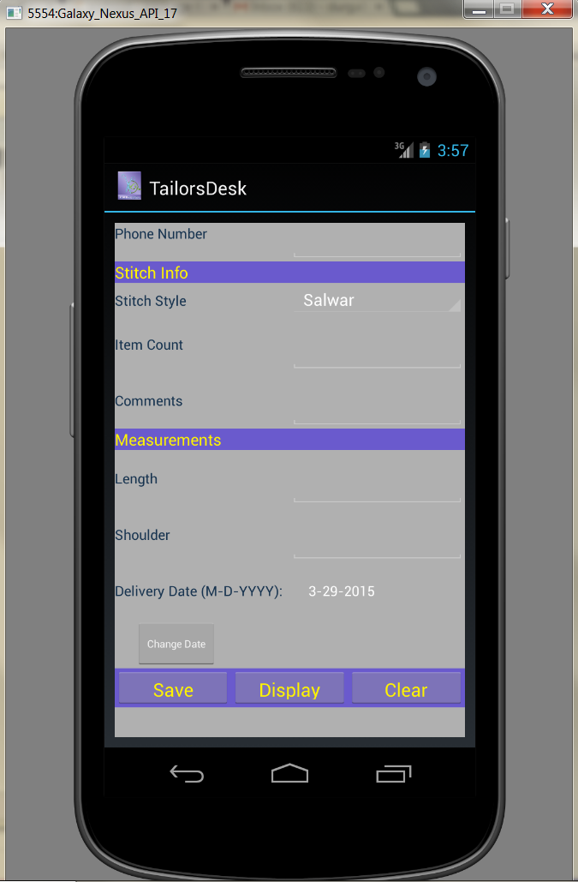
More data on Home Page with scrolling facility

Slide 7
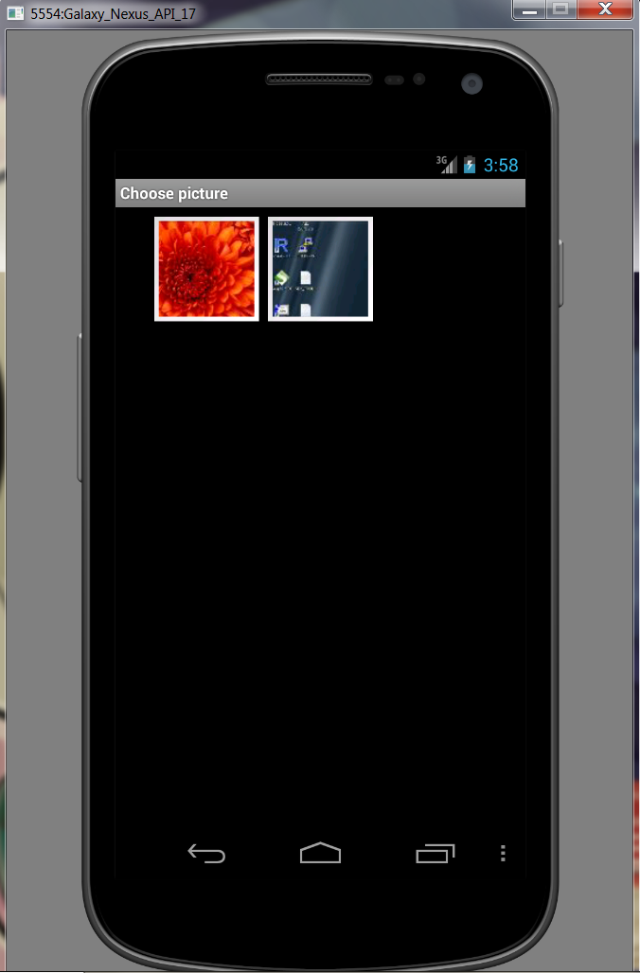
Gallery when tailor clicks on Load Picture

Slide 8
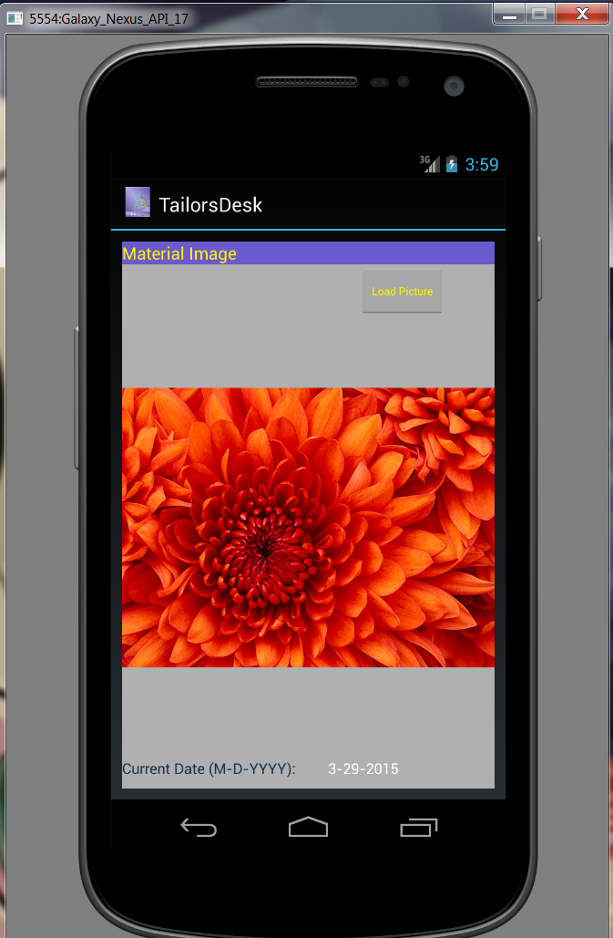
Home Page after selecting the image

Slide 9
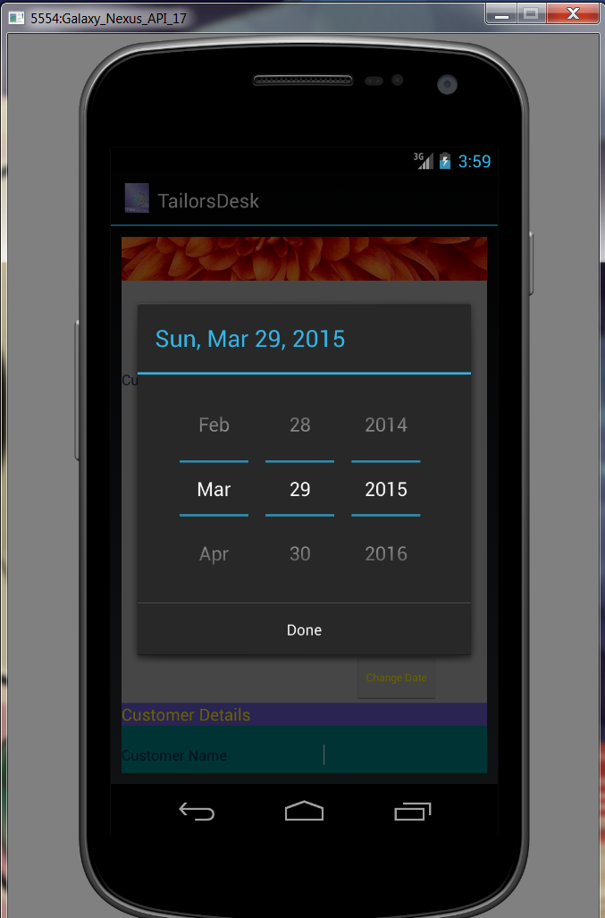
User clicks on Change Date button

Slide 10
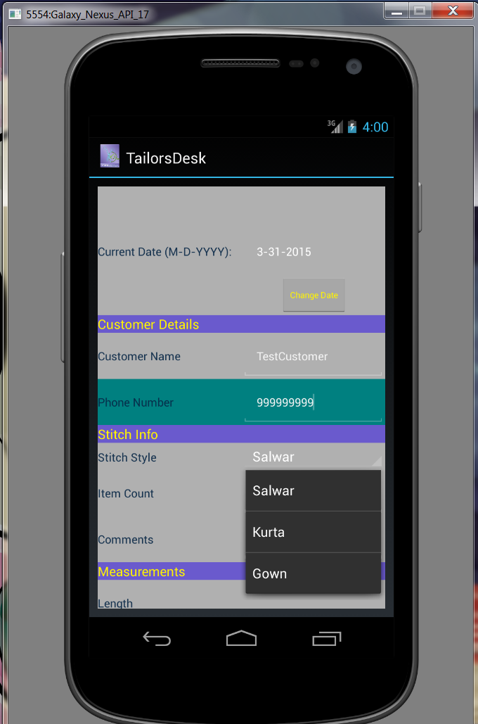
Homepage with data entered

Slide 11
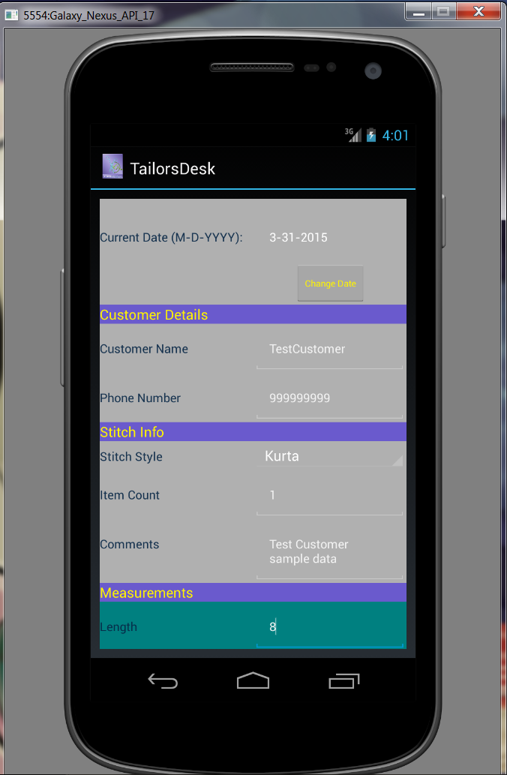
More info on Home Page

Slide 12
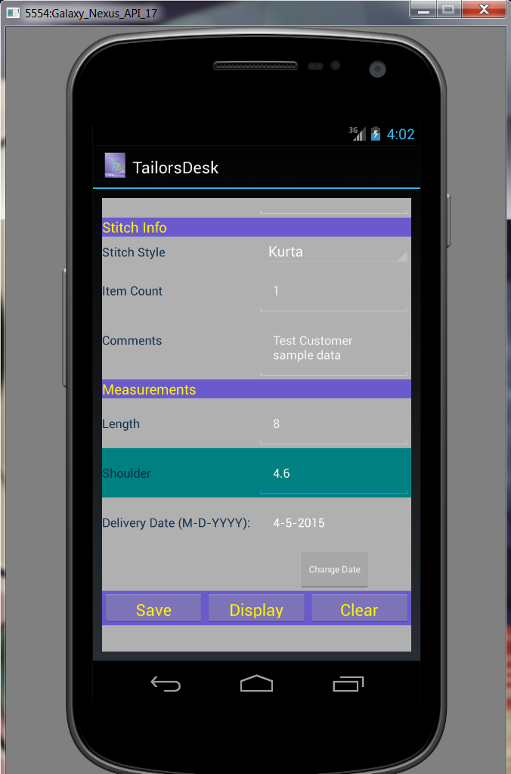
Option to save, display and clear

Slide 13
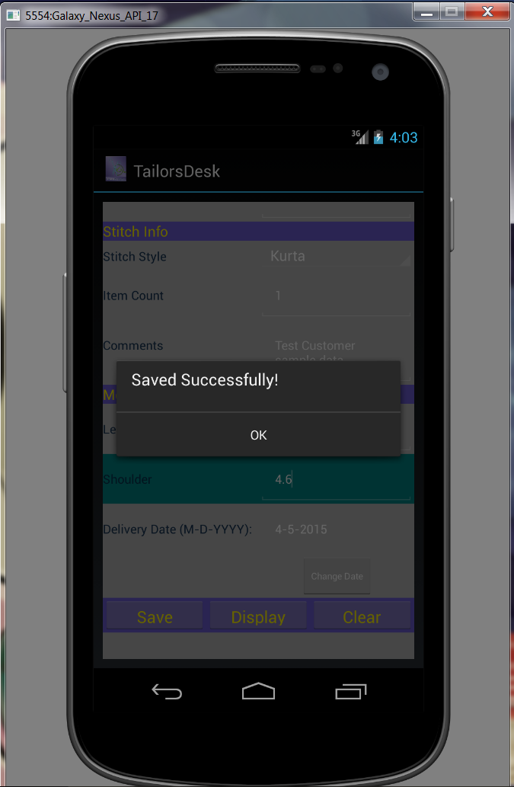
Confirmation message when user Save

Slide 14
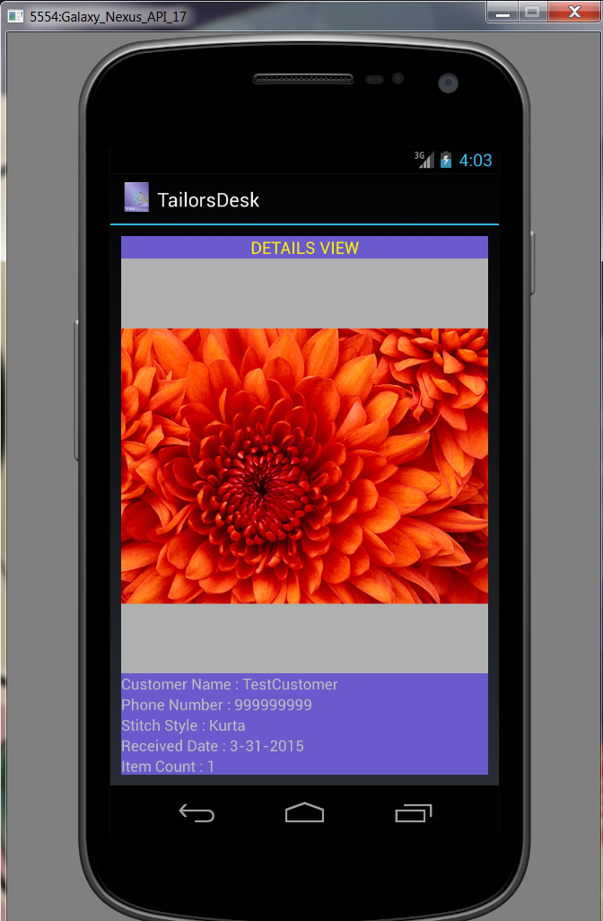
Saved data View when user clicks on Display

Slide 15
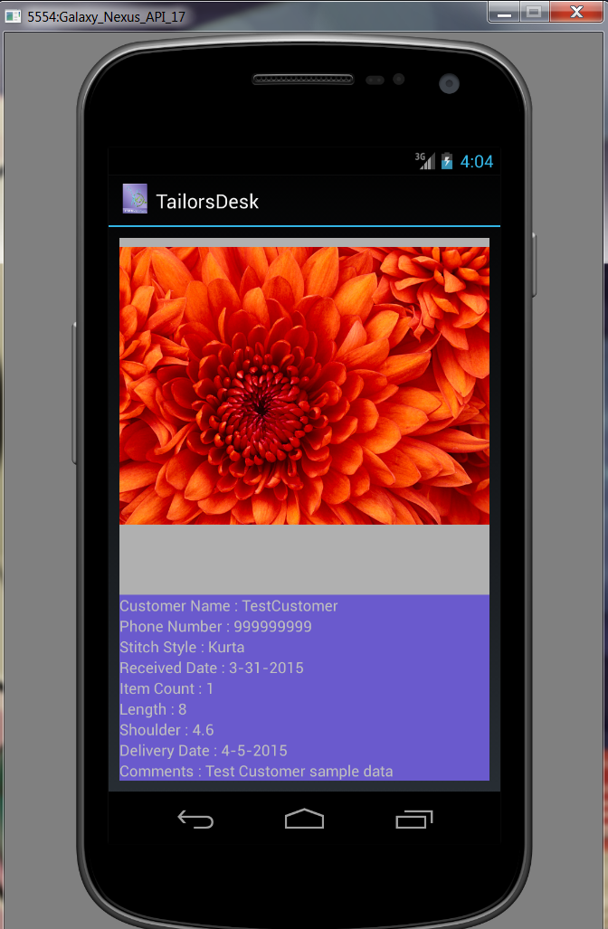
More data on Details view

Slide 16
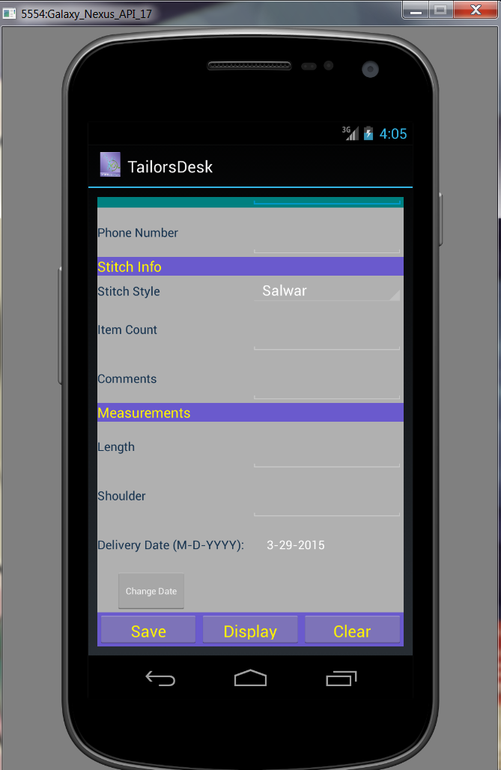
Home page on Clear

Slide 17
☺ THANK YOU! ☺

